Slide 1
CHAPTER 11
More Experiments

Slide 2
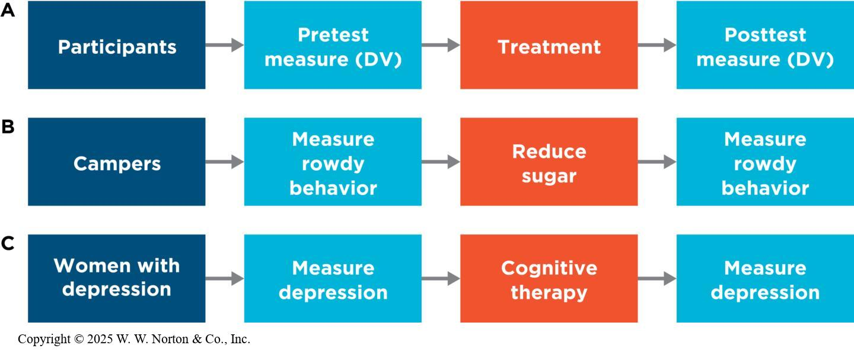
The Really Bad Experiment (A Cautionary Tale): Diagram
Also known as one-group pretest/posttest design
Notes:
Figure 11.1: The Really Bad Experiment
(A) A general diagram of the really bad experiment, or the one-group, pretest/posttest design. Unlike the pretest/posttest design, it has only one group and no comparison condition. (B, C) Possible ways to diagram two of the examples given in the text. Using these as a model, try sketching a diagram of the Go Green example.
The three examples on this slide illustrate what is known as the really bad experiment. Part A is a general diagram, and parts B and C are diagrams of specific studies discussed in the text. The really bad experiment is also known as a one-group pretest/posttest design, which means that there is one group of participants who are measured on a pretest, exposed to a treatment, intervention, or change, and then measured on a posttest. Such a design is problematic because it is vulnerable to threats to internal validity.
Copyright © 2025 W. W. Norton & Co., Inc.

Slide 3
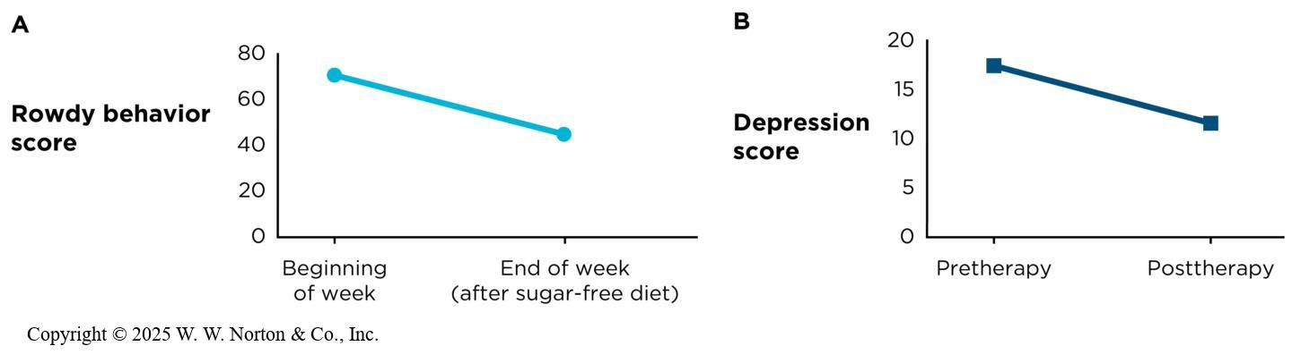
The Really Bad Experiment (A Cautionary Tale): Graphic
Also known as one-group pretest/posttest design
Notes:
Figure 11.2: Graphing the Really Bad Experiment
The first two examples can be graphed this way. Using these as a model, try sketching a graph of the Go Green example.
The results from the examples in parts B and C of the previous slide are graphed here.
Copyright © 2025 W. W. Norton & Co., Inc.

Slide 4
Six Potential Internal Validity Threats in One-Group, Pretest/Posttest Designs
Maturation threats to internal validity
History threats to internal validity
Regression threats to internal validity
Attrition threats to internal validity
Testing threats to internal validity
Instrumentation threats to internal validity
Combined threats
Notes:
This chapter covers 12 threats to internal validity.
The first 3 were covered in the last chapter: design confounds, selection effects, and order effects.
The 6 threats listed on this slide apply especially to the really bad experiment: maturation threats, history threats, regression threats, attrition threats, testing threats, and instrumentation threats.
And the final 3 threats (observer bias, demand characteristics, and placebo effects) are applicable to any experiment.

Slide 5
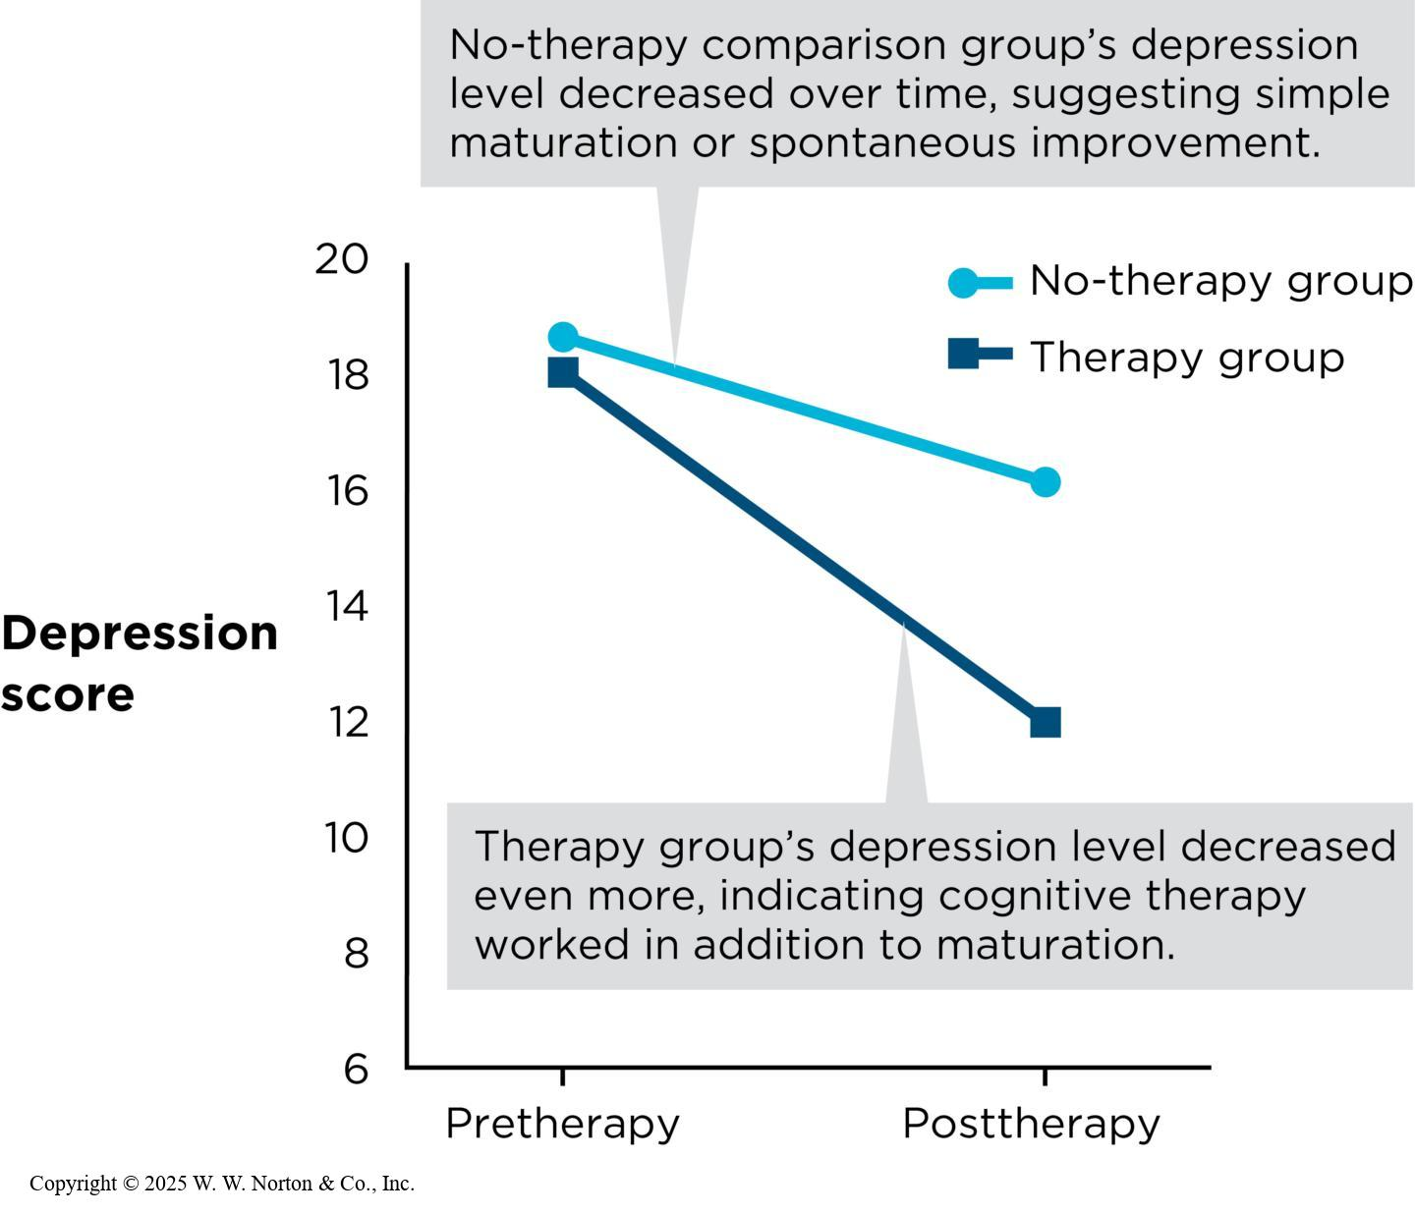
Maturation Threats to Internal Validity
What are maturation threats?
How are maturation threats prevented?
Notes:
Figure 11.3: Maturation Threats
A pretest/posttest design would help control for the maturation threat in Dr. Yuki’s depression study.
Maturation threat: A change in behavior that emerges spontaneously over time.
For example: Children become better and faster at solving addition and subtraction problems as they get older, trees grow taller with age, and over time, some people tend to recover on their own from various psychological disorders.
Prevention: In a really bad experiment, remember that there is only one group of participants and they are getting the treatment. However, in a true experiment there is a comparison group in order to prevent maturation threats.
In the depression study graphed here, a comparison group has been added to Dr. Yuki’s really bad experiment. Notice that the two groups are quite similar in their depression scores at pretest, but the depression scores at posttest differ, with the therapy group having lower depression scores than the no-therapy group.
Thus, the effect of maturation can be “subtracted out” when interpreting the results of this study and a maturation threat has thus been prevented.
Copyright © 2025 W. W. Norton & Co., Inc.

Slide 6
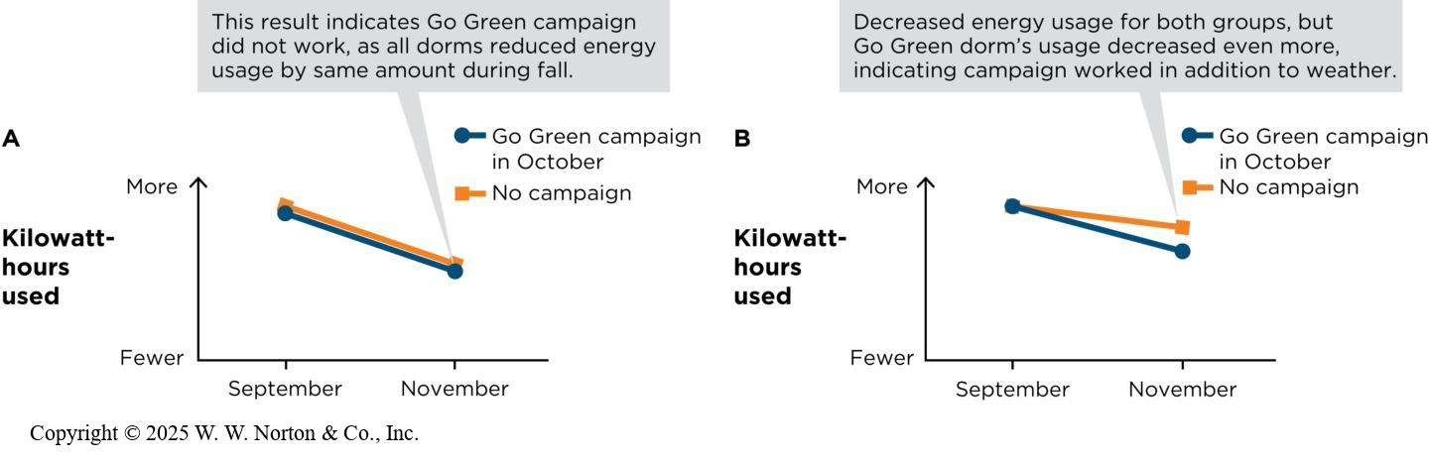
History Threats to Internal Validity
What is a history threat?
How are history threats prevented?
Notes:
Figure 11.4: History Threats
A comparison group would help control for the history threat of seasonal differences in electricity usage.
History threats result when some external or “historical” event affects most members of the treatment group at the same time as the treatment, making it unclear whether the change in the DV for the experimental group was the result of the treatment or the result of the historical factor.
For example: Suppose you were studying the effects of meditation on stress levels among college students, and while you were conducting the study, a violent event occurred on the college campus at which you were collecting your data. The meditation group did not show significant decreases in stress levels as expected, but was that because the treatment wasn't effective? Perhaps it was effective but the campus violence raised people's stress levels, which made it look like it was not effective.
Prevention: For example, the figure on this slide shows two graphs from the Go Green study mentioned in the text. In the graph on the left, it appears that the experimental and comparison groups both had similar declines in electrical usage from September to November because of the change of seasons. Therefore, it looks like the Go Green campaign had no effect. However, in the graph on the right, you can see that the treatment group decreased its usage more than the comparison group. Thus, we can rule out the history threat and conclude that it was the treatment that caused the decrease.
Copyright © 2025 W. W. Norton & Co., Inc.

Slide 7
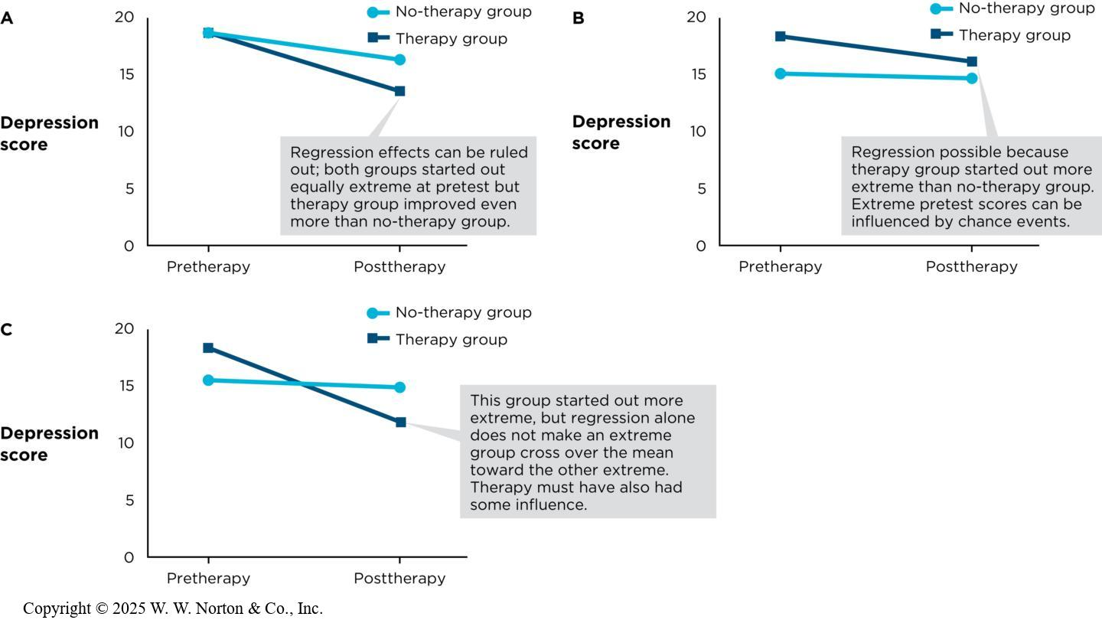
Regression Threats to Internal Validity
What is a regression threat?
How does regression affect internal validity?
How can regression threats be prevented?
Notes:
Figure 11.5: Regression Threats to Internal Validity
Regression to the mean can be analyzed by inspecting different patterns of results.
Regression threat (also known as regression to the mean): A statistical concept in which extremely low or extremely high performance at Time 1 is likely to be less extreme at Time 2 (i.e., closer to average). For example: If you’re in a really good mood or a really bad mood, due to regression, you will probably be in a more moderate mood tomorrow.
Regression and internal validity: Regression threats only occur in pretest/posttest designs. Specifically, they only occur when a group has an extreme pretest score (high or low). You can anticipate that the scores of those participants will regress toward the mean at posttest.
Prevention: Regression threats can be avoided by using comparison groups and inspecting the results. If you look at the top graph, you can see that both groups had similar levels of depression at pretest, but the therapy group had lower levels of depression at posttest than the no-therapy group. Regression can be ruled out, and we can conclude that the therapy worked.
The middle graph shows the possibility of a regression threat because the two groups don’t start out with equal depression scores at pretest (the therapy group has more severe depression). At posttest, the therapy group’s level of depression has declined from the level at the time of the pretest, but it’s still greater than that of the no-therapy group. Therefore, it’s not clear whether the decline occurred because of statistical regression or because of the treatment.
The bottom graph depicts the therapy group starting out with higher depression scores than the no-therapy group, but this pattern is reversed at posttest, when the no-therapy group had higher depression scores than the therapy group. This could not be accounted for by regression alone. Therefore, the IV must have had an effect on the DV.
Copyright © 2025 W. W. Norton & Co., Inc.

Slide 8
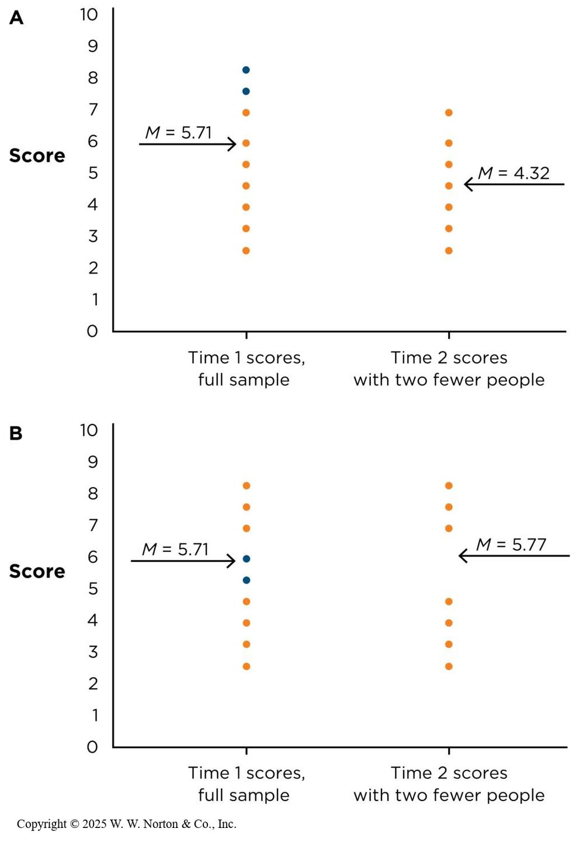
Attrition Threats to Internal Validity
What is an attrition threat?
How can attrition threats be prevented?
Notes:
Figure 11.6: Attrition Threats
(A) If two people (noted by blue dots) drop out of a study, both of whom scored at the high end of the distribution on the pretest, the group mean changes substantially when their scores are omitted, even if all other scores stay the same.
(B) If the dropouts’ scores on the pretest are close to the group mean, removing their scores does not change the group mean as much.
Attrition threat: A reduction in participant numbers from pretest to posttest. Attrition is only problematic when it is systematic. In the top graph, two people drop out of the study from pretest to posttest, and those individuals scored at the high end of the distribution (systematic). This decreases the posttest mean dramatically. You don’t know whether it was the attrition or the IV causing the decrease.
However, in the bottom graph, the participants who drop out have scores closer to the mean, so removing their scores doesn’t dramatically change the group mean at posttest. Therefore, attrition isn’t a threat.
Prevention: When participants drop out of a study, one way to prevent attrition is to have the researcher remove their scores from the pretest average. Another approach is to look at the pretest scores of dropouts. If they have extreme scores, then they are more likely to threaten internal validity than if they have more moderate scores.
Copyright © 2025 W. W. Norton & Co., Inc.

Slide 9
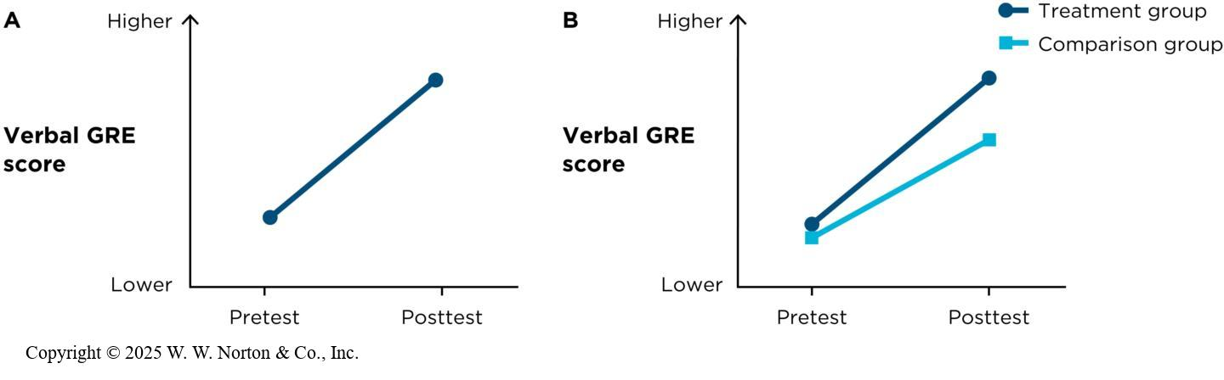
Testing Threats to Internal Validity
What is a testing threat?
How are testing threats prevented?
Notes:
Figure 11.7: Testing Threats
(A) If there is no comparison group, it’s hard to know whether the improvement from pretest to posttest is caused by the treatment or simply by practice. (B) The results from a comparison group can help rule out testing threats. Both groups might improve, but the treatment group improves even more, suggesting that both practice and a true effect of the treatment are causing the improvement.
Testing threat: A type of order effect in which there is a change in participants as a result of experiencing the DV (the test) more than once. Their scores might go up due to practice (practice effect), or their scores might go down due to fatigue (fatigue effect). Testing threats affect internal validity because it’s not clear if the treatment caused the change in the DV or whether practice or fatigue did.
Prevention: One way to prevent testing threats is not to use a pretest (posttest-only design). Another way is to use alternative forms of the test at pretest and posttest.
Having a comparison group is also helpful (see Figure 11.7). You can rule out testing threats if both groups take the pretest and the posttest, but the treatment group exhibits a larger change than the comparison group.
Copyright © 2025 W. W. Norton & Co., Inc.

Slide 10
Instrumentation Threats to Internal Validity
What is an instrumentation threat?
How can instrumentation threats be prevented?
Instrumentation threats versus testing threats
Notes:
Instrumentation threat (aka instrumentation decay): Occurs when a measuring instrument changes over time.
For example: Observers change their observation criteria over time, or a researcher uses different forms of a test at pretest and posttest and they’re not equivalent forms.
Prevention: One way to prevent instrumentation threats is to use a posttest-only design. However, if you need a pretest/posttest design, you should make sure that your pretest and posttest forms are equivalent. In terms of making observations, you might retrain your observers throughout the study. Finally, you might counterbalance the order of the pretest and posttest forms, such that some participants get Form A at pretest, and some get Form B, and then they get the other form at posttest.
Instrumentation versus testing threats: In an instrumentation threat, the measuring instrument has changed from Time 1 to Time 2, whereas in a testing threat, the participant changes over the period between Time 1 and Time 2.

Slide 11
Combined Threats
Selection-history threat: An outside event or factor systematically affects participants at one level of the IV.
Selection-attrition threat: Participants in only one experimental group experience attrition.
Notes:
Sometimes, in a pretest/posttest design, two types of threats to internal validity may work together.
Selection-history threat: Suppose students at one university were in your treatment group and students at another university were in your control group in a study of the effects of meditation on stress. However, during the course of the study, a stressful event occurs on one of the campuses.
Selection-attrition threat: Let’s say that participants in one group have to travel 1 mile for the study, and participants in the other group have to travel 20 miles for the study. You might have more attrition in the 20-mile group due to the distance from the lab, so you could be sure if differences between groups were due to the IV or the distance and attrition.

Slide 12
Three Potential Internal Validity Threats in Any Study
Observer bias
Demand characteristics
    Controlling for observer bias and demand characteristics (double-blind study, masked study)
Placebo effects
Notes:
Observer bias, demand characteristics, and placebo effects are three more potential threats to internal validity, and they can occur, not only in the very bad experiment (one-group pretest/posttest design), but also in experiments that have a comparison group.
Observer bias: Bias caused by researchers’ expectations influencing how they interpret the results.
Example: Dr. Yuki might be a biased observer of her patients’ depression: She expects to see her patients improve, whether they do or do not. Nikhil may be a biased observer of his campers: He may expect the low-sugar diet to work, so he views the boys’ posttest behavior more positively.
Although comparison groups can prevent many threats to internal validity, they do not necessarily control for observer bias. Even if Dr. Yuki used a no-therapy comparison group, observer bias could still occur: If she knew which participants were in which group, her biases could lead her to see more improvement in the therapy group than in the comparison group.
Demand characteristics: Bias that occurs when participants figure out what a research study is about and change their behavior in the expected direction. In order to control for observer bias and demand characteristics, a researcher can conduct a double-blind study, which is designed so that neither the participants nor the experimenters working with the participants know who is in the treatment group and who is in the control group. If a double-study isn’t feasible, then an acceptable alternative is a masked design (aka blind design; participants know which group they’re in but observers don’t).
Placebo effects: See the next slide.

Slide 13
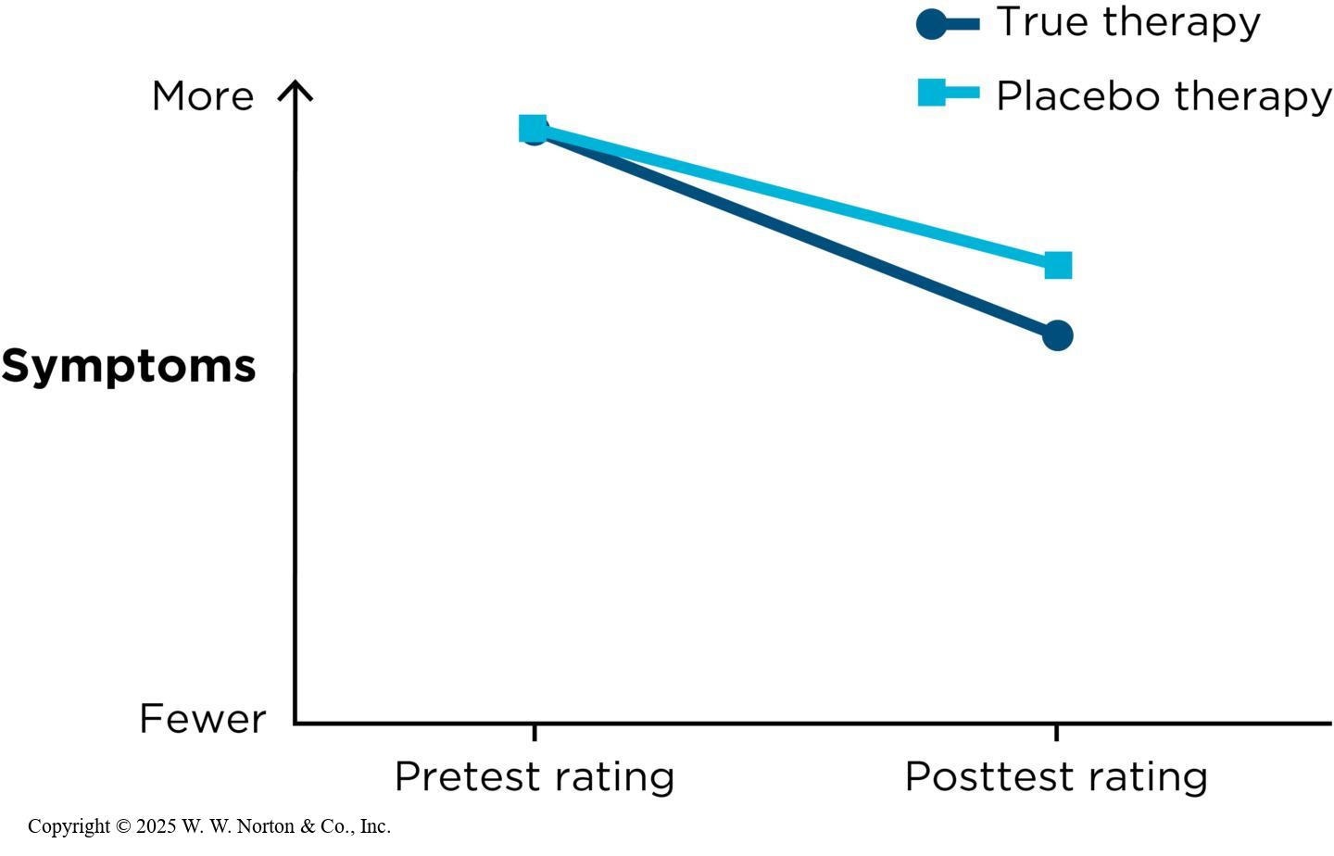
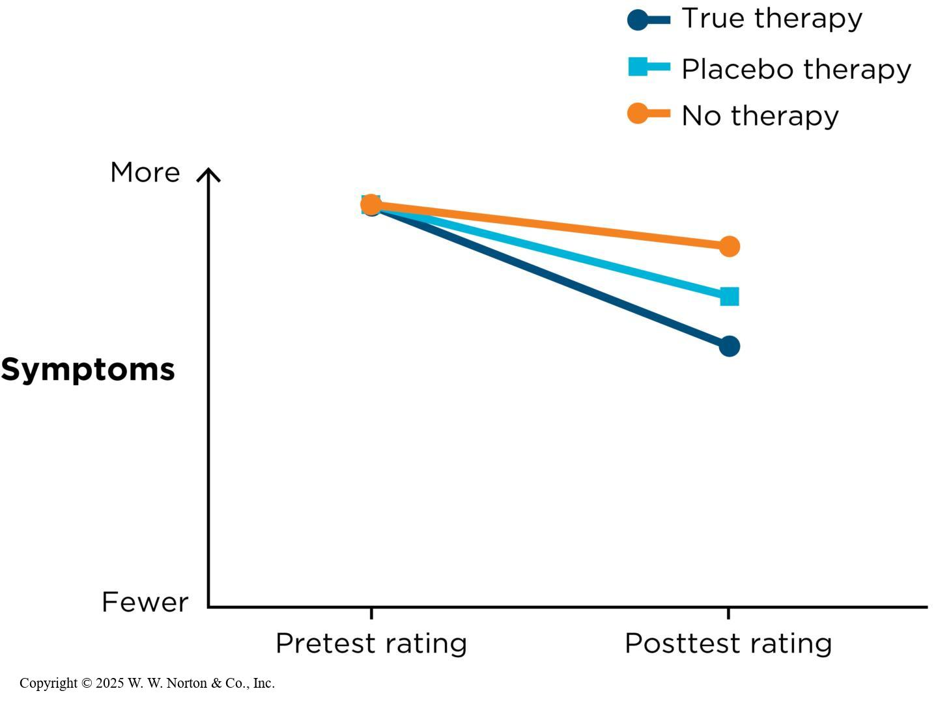
Placebo Effects
Designing studies to rule out the placebo effect (double-blind placebo control study)
Is that really a placebo effect?
Notes:
Figure 11.9: A Double-Blind Placebo Control Study
Adding a placebo comparison group can help researchers separate a potential placebo effect from the true effect of a particular therapy.
Copyright © 2025 W. W. Norton & Co., Inc.
Figure 11.10: Identifying a Placebo Effect
Definitively showing a placebo effect requires three groups: one receiving the true therapy, one receiving the placebo, and one receiving no therapy. If there is a placebo effect, the pattern of results will show that the no-therapy group does not improve as much as the placebo group.
Placebo effect: This effect is present when people receive a treatment and improve, but only because they believe they are receiving a valid or effective treatment.
For example: Participants are told they are receiving a new therapy, pill, or injection, but in fact it’s missing the active ingredient, or they may be told they are getting a new type of therapy but in fact simply chatted with someone and didn’t get any therapy. Nonetheless, participants may improve because they thought they had had therapy. It’s important to note that placebo effects aren’t imaginary. In fact, placebos can be strong treatments.
Designing studies to rule out the placebo effect: In order to rule out the placebo effect, a special comparison group is used that is receiving the placebo therapy or placebo medication, but neither the people working with the participants nor the participants know who is in which group (double-blind placebo control study). It is considered one of the strongest designs in medical and intervention research.
In the figure on the left, you can see that both groups’ symptoms decreased. However, the group getting the true therapy started to feel better more than the group getting the placebo therapy, which suggests that the therapy had some effect.
Is that really a placebo effect? In the figure on the left that we just talked about, there might not be a placebo effect. However, perhaps some of the improvement was due to maturation, history, regression, testing, or instrumentation threats? In order to determine whether there is in fact a placebo effect, the researcher might add a third comparison group that doesn’t receive the true therapy and doesn’t receive the placebo therapy. They don’t receive any therapy at all. If you have a placebo effect (see the graph on the right), then the no treatment group should not improve as much as the placebo group.
Copyright © 2025 W. W. Norton & Co., Inc.

Slide 14
With So Many Threats, Are Experiments Still Useful?
Threats 1–5
Table 11.1 Asking About Internal Validity Threats in Experiments
Design confound | A second variable that unintentionally varies systematically with the independent variable. | From Chapter 10: If the diversity norms poster waiting room also had other people in it, and the flu shot poster waiting area did not. | Did the researchers turn potential third variables into control variables—for example, keeping social factors constant?
Selection effect | In an independent-groups design, when the two independent variable groups have systematically different kinds of participants in them. | From Chapter 10: In the autism study, some parents insisted they wanted their children to be in the intensive-treatment group rather than the control group. | Did the researchers use random assignment or matched groups to equalize groups?
Order effect | In a repeated-measures design, when the effect of the independent variable is confounded with carryover from one level to the other, or with practice, fatigue, or boredom. | From Chapter 10: People rated the shared chocolate higher only because the first taste of chocolate is always more delicious than the second one. | Did the researchers counterbalance the orders of presentation of the levels of the independent variable?
Maturation | An experimental group improves over time only because of natural development or spontaneous improvement. | Disruptive boys settle down as they get used to the camp setting. | Did the researchers use a comparison group of boys who had an equal amount of time to mature but who did not receive the treatment?
History | An experimental group changes over time because of an external factor that affects all or most members of the group. | Dorm residents use less air conditioning in November than September because the weather is cooler. | Did the researchers include a comparison group that had an equal exposure to the external factor but did not receive the treatment?
Notes:
Table 11.1: Asking About Internal Validity Threats in Experiments
We have discussed 12 threats to internal validity, and they are summarized in this table. With so many potential threats out there to internal validity, why do we bother to conduct experiments?
First, a number of threats described here are only an issue in the one-group pretest/posttest design. But if researchers design their studies well using comparison groups, reliable coding procedures, double-blind designs, placebo conditions, and control variables, then they can prevent these threats to internal validity.
Copyright © 2025 W. W. Norton & Co., Inc.

Slide 15
With So Many Threats, Are Experiments Still Useful?
Threats 6–12
Table 11.1 Asking About Internal Validity Threats in Experiments—cont’d
Regression to the mean | An experimental group whose average is extremely low (or high) at pretest will get better (or worse) over time because the random events that caused the extreme pretest scores do not recur the same way at posttest. | A group’s score on a depression index is extremely high at pretest, in part because some members volunteered for therapy when they were feeling much more depressed than usual. | Did the researchers include a comparison group that was equally extreme at pretest but did not receive the therapy?
Attrition | An experimental group changes over time, but only because the most extreme cases have systematically dropped out and their scores are not included in the posttest. | Because the most rambunctious boy in the cabin leaves camp early, his unruly behavior affects the pretest mean but not the posttest mean. | Did the researchers compute the pretest and posttest scores with only the final sample included, removing any dropouts’ data from the pretest group average?
Testing | A type of order effect: An experimental group changes over time because repeated testing has affected the participants. Practice effects (fatigue effects) are one subtype. | GRE verbal scores improve only because students take the same version of the test both times and therefore are more practiced at posttest. | Did the researchers have a comparison group take the same two tests? Did they use a posttest-only design, or did they use alternative forms of the measure for the pretest and posttest?
Instrumentation | An experimental group changes over time, but only because the measurement instrument has changed. | Coders get more lenient over time, so the same behavior is coded as less disruptive at posttest than at pretest. | Did the researchers train coders to use the same standards when coding? Are pretest and posttest measures demonstrably equivalent?
Observer bias | An experimental group’s ratings differ from those of a comparison group but only because the researcher expects the groups’ ratings to differ. | The researcher expects a low-sugar diet to decrease the campers’ unruly behavior, so he notices only calm behavior and ignores wild behavior. | Were the observers of the dependent variable unaware of which condition participants were in?
Demand characteristic | Participants guess what the study’s purpose is and change their behavior in the expected direction. | Campers guess that the low-sugar diet is supposed to make them calmer, so they change their behavior accordingly. | Were the participants kept unaware of the purpose of the study? Was it an independent-groups design, which makes participants less able to guess the study’s purpose?
Placebo effect | Participants in an experimental group improve only because they believe in the efficacy of the therapy or drug they receive. | Women receiving cognitive therapy improve simply because they believe the therapy will work for them. | Did a comparison group receive a placebo (inert) drug or a placebo therapy?
Notes:
Table 11.1: Asking About Internal Validity Threats in Experiments (continued)
We have discussed 12 threats to internal validity, and they are summarized in this table. With so many potential threats out there to internal validity, why do we bother to conduct experiments?
First, a number of threats described are only an issue in the one-group pretest/posttest design. But if researchers design their studies well using comparison groups, reliable coding procedures, double-blind designs, placebo conditions, and control variables, then they can prevent these threats to internal validity.
Copyright © 2025 W. W. Norton & Co., Inc.

Slide 16
Interrogating Null Effects: What If the Independent Variable Does Not Make a Difference? (1 of 2)
Perhaps there is not enough between-groups difference.
Perhaps within-groups variability obscured the group differences.
Perhaps there really is no difference.
Null effects can be hard to find.
Notes:
What happens when a study finds a null effect (aka null result)? In other words, what if the independent variable did not affect the dependent variable, so there is no significant covariance between the IV and the DV? Typically, null effects aren’t discussed much in the popular media because they are more focused on effects in which the IV does affect the DV.

Slide 17
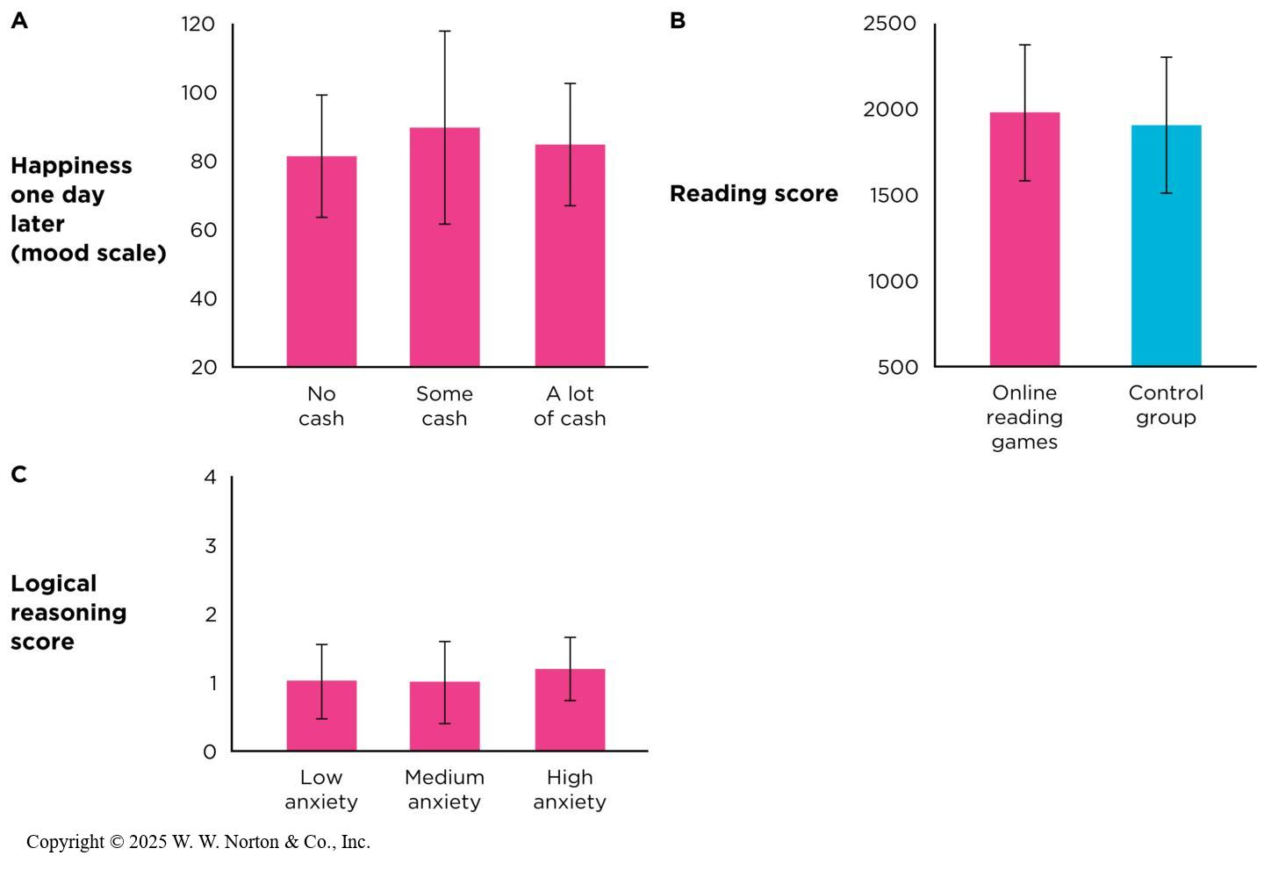
Interrogating Null Effects: What If the Independent Variable Does Not Make a Difference? (2 of 2)
Notes:
Figure 11.11: Results of Three Hypothetical Experiments Showing a Null Effect
(A) Why might cash not have made people significantly happy? (B) Why might the online reading games not have worked? (C) Why might anxiety not have affected logical reasoning? Error bars represent fabricated 95% CIs.
What if the independent variable did not make much difference in the dependent variable? What if the 95% CI for the effect includes zero, such as a 95% of [-.21, .18]? Such an outcome is called a null effect, and in research, it is surprisingly common.
The three graphs in this figure all come from posttest-only designs. However, null effects can happen in pretest/posttest designs, in within-groups designs, and even in correlational studies.
In graph A, money didn’t cause participants to feel happier. Why? In graph B, taking a GRE prep course didn’t have a significant effect on GRE scores. Why? In graph C, anxiety didn’t affect logical reasoning scores. Why?
Sometimes when a study has a null effect, it might be that the IV really didn’t affect the DV. Other times, when there’s a null result, it’s because the study wasn’t designed or conducted properly, so the IV actually did cause the DV, but some obscuring factor got in the way of the researchers detecting the difference.
There are two types of obscuring factors: (1) There might not have been enough difference between groups, or (2) there might have been too much variability within groups. Let’s look at each of these types in detail.
Copyright © 2025 W. W. Norton & Co., Inc.

Slide 18
Perhaps There Is Not Enough Between-Groups Difference
Weak manipulations
Insensitive measures
Ceiling and floor effects
Manipulation checks to help detect weak manipulations, ceilings, and floors
Design confound acting in reverse
Notes:
Sometimes, the cause of a null result is not enough between-groups difference. This might occur because of weak manipulations, insensitive measures, ceiling or floor effects, or a reverse design confound.
Weak manipulations: Based on the three examples we just looked at in the discussion of null effects, we can think of them in terms of weak manipulations. Perhaps in the study on money and mood, with the levels of the IV being no cash, 25 cents, or a dollar, that just wasn’t enough money to affect people’s mood. The difference didn’t really matter.
Insensitive measures: Sometimes, a null result occurs because the researchers haven’t operationalized the DV with enough sensitivity. In the GRE prep course example, perhaps taking a prep course improves people’s scores by 10 points. If you were using a pass/fail measure or even groups like high, medium, and low, you wouldn’t detect the change. Your best bet is to use very detailed, quantitative increments instead of just two or three levels.

Slide 19
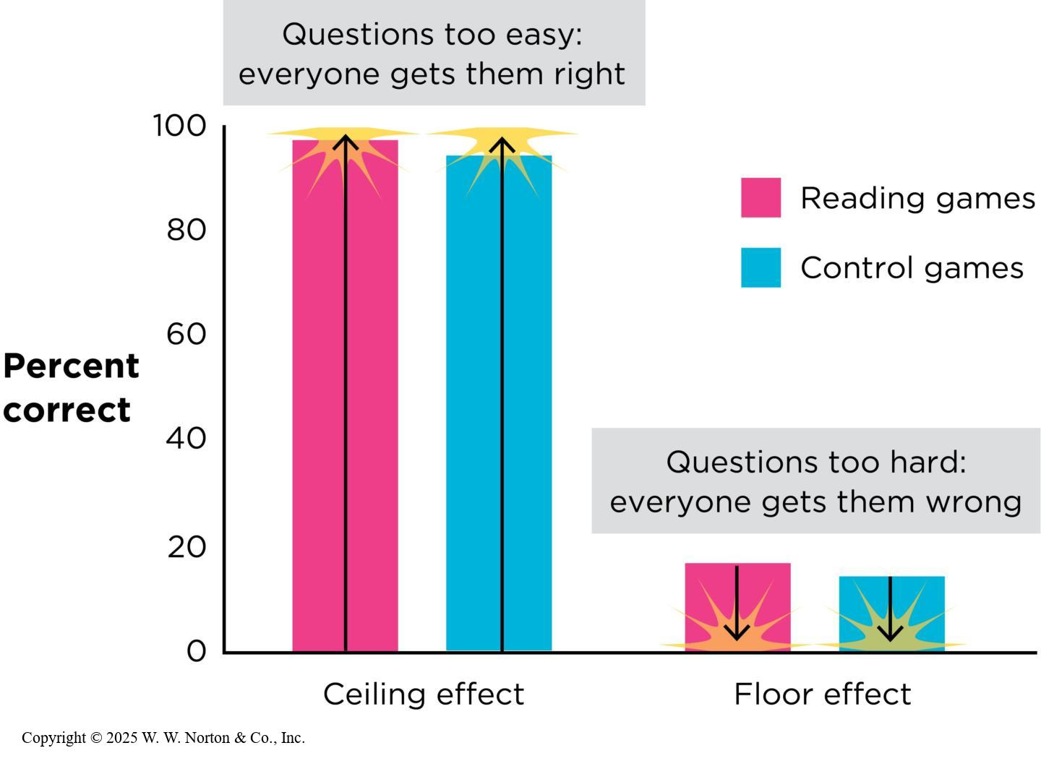
Ceiling and Floor Effects
Ceiling effect
Floor effect
Ceilings, floors, and IVs
Ceilings, floors, and DVs
Notes:
Figure 11.12: Ceiling and Floor Effects
A ceiling or floor effect on the dependent variable can obscure a true difference between groups. If all the questions on a test are too easy, everyone will get a perfect score. If the questions are too hard, everyone will score low.
Ceiling effect: The participants’ scores on the DV are clustered at the high end (for example, when giving college students a simple addition test).
Example: Suppose the researcher manipulated anxiety by telling the groups they were about to receive an electric shock. The low-anxiety group was told to expect a 10-volt shock, the medium-anxiety group was told to expect a 50-volt shock, and the high-anxiety group was told to expect a 100-volt shock. This manipulation would probably result in a ceiling effect because expecting any amount of shock would cause anxiety, regardless of the shock’s intensity. As a result, the various levels of the independent variable would appear to make no difference
Floor effect: The participants’ scores on the DV are clustered at the low end.
Example: If a researcher really did manipulate the independent variable by giving people $0.00, $0.25, or $1.00, that would be a floor effect because these three amounts are all low—they’re squeezed close to a floor of $0.00
Ceilings, floors, and IVs: Sometimes, ceiling and floor effects can be the result of a problematic IV, as in the money and mood study, in which all three levels of the IV were very low amounts of money: none, 25 cents, or a dollar.
Ceilings, floors, and DVs: Poorly designed DVs can also cause ceiling and floor effects. If you look at the graph, you can see an example illustrating a ceiling effect and a floor effect on the DV and how that can obscure group gender differences on the IV.
Copyright © 2025 W. W. Norton & Co., Inc.

Slide 20
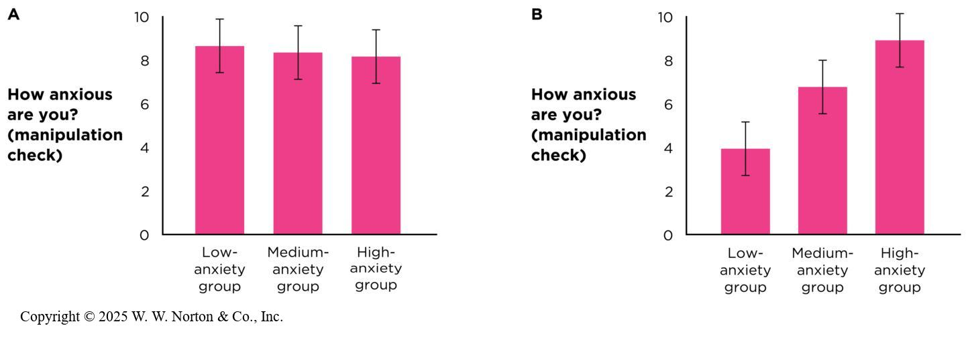
Manipulation Checks Help Detect Weak Manipulations, Ceilings, and Floors
Manipulation check
Notes:
Figure 11.13: Possible Results of a Manipulation Check
(A) These results suggest the anxiety manipulation did not work because people at all three levels of the independent variable reported being equally anxious. (B) These results suggest the manipulation did work because the anxiety of people in the three independent variable groups did vary in the expected way. Error bars depict fabricated 95% CIs.
A manipulation check is a second DV included in a study to make sure the IV manipulation worked.
In the manipulation check depicted on the left, it appears that the anxiety manipulation didn’t work, as the three anxiety groups self-reported very similar levels of anxiety.
In the graph on the right, it looks like the anxiety manipulation worked, as it seems to differentiate the three different IV groups as would be expected.
Copyright © 2025 W. W. Norton & Co., Inc.

Slide 21
Design Confounds Acting in Reverse
Although confounds usually threaten internal validity, they can apply to null effects.
Notes:
A design confound can counteract the true effect of an IV.
Example: In the GRE study, perhaps that test-prep group was also under additional pressure to perform well on the GRE. As a result, they were actually receiving test prep and pressure, while the no-test prep group didn’t have test prep or pressure.
The added pressure that was applied is considered a confound. However, it didn’t work in favor of the test-prep group; it worked against them by lowering their scores.

Slide 22
Perhaps Within-Groups Variability Obscured the Group Differences
Measurement error
Individual differences
Situation noise
Another name for these solutions: power
Notes:
Another cause of a null effect might be that there is too much within-groups variability (aka noise, error variance, or unsystematic variability). Having too much noise can get in the way of detecting between-group differences.
If you look at the two graphs, you will notice that the within-groups variability is larger in graph A than in graph B. You can see this by examining the length of the error bars in the bar graphs or by examining the spread of the individual scores in the scatterplots. Notice how having more within-groups variability obscures the group differences.
Let’s look at the different causes of too much variability within groups: measurement error, individual differences, and situation noise.

Slide 23
Measurement Error
Solutions for reducing measurement error
    Using reliable, precise measurements
    Measuring more instances
Notes:
Measurement error: Any factor that can inflate or deflate a person’s true score on the DV. Example: A man who is 160 centimeters tall might be measured at 160.5 cm because of the angle of vision of the person using the meter stick, or he might be recorded as 159.5 cm because he slouched a bit. The goal is to keep measurement error as small as possible.
Solutions for reducing measurement error
Use reliable, precise measurements: Measurement errors are reduced when researchers use measurement tools that are reliable (internal, interrater, and test/retest) and that are valid (i.e., have good construct validity).
Measure more instances: If researcher can’t find a measurement tool that’s reliable and valid, then the best alternative is to measure a larger sample of participants. Random errors will cancel each other out with more people in the sample.

Slide 24
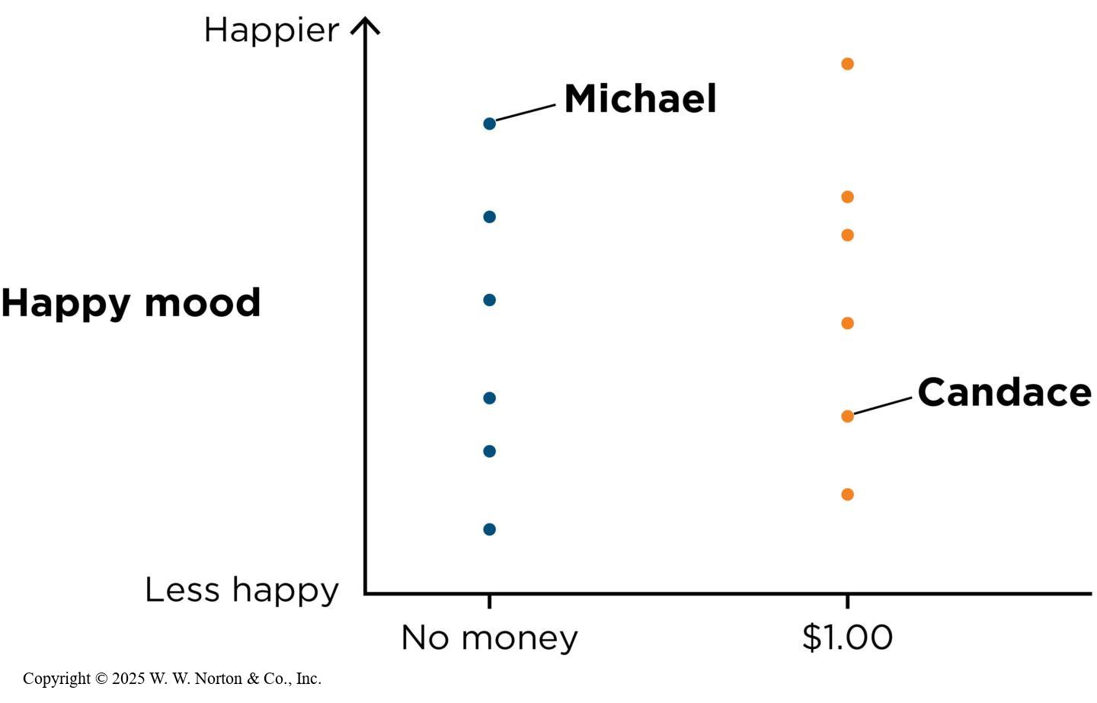
Individual Differences
Individual differences spread out scores within each group.
Notes:
Figure 11.15: Individual Differences
Overall, students who received money were slightly more cheerful than students in the control group, but the scores in the two groups overlapped a great deal.
Another source of within-group variability is individual differences. Some people are faster runners than others, some are smarter, some are funnier, and so on.
In the graph, you can see how participants who received money were slightly more cheerful than those who did not receive money, but there was a lot of overlap in the two conditions. Thus, the individual differences within each group obscured the between-groups difference.
Copyright © 2025 W. W. Norton & Co., Inc.

Slide 25
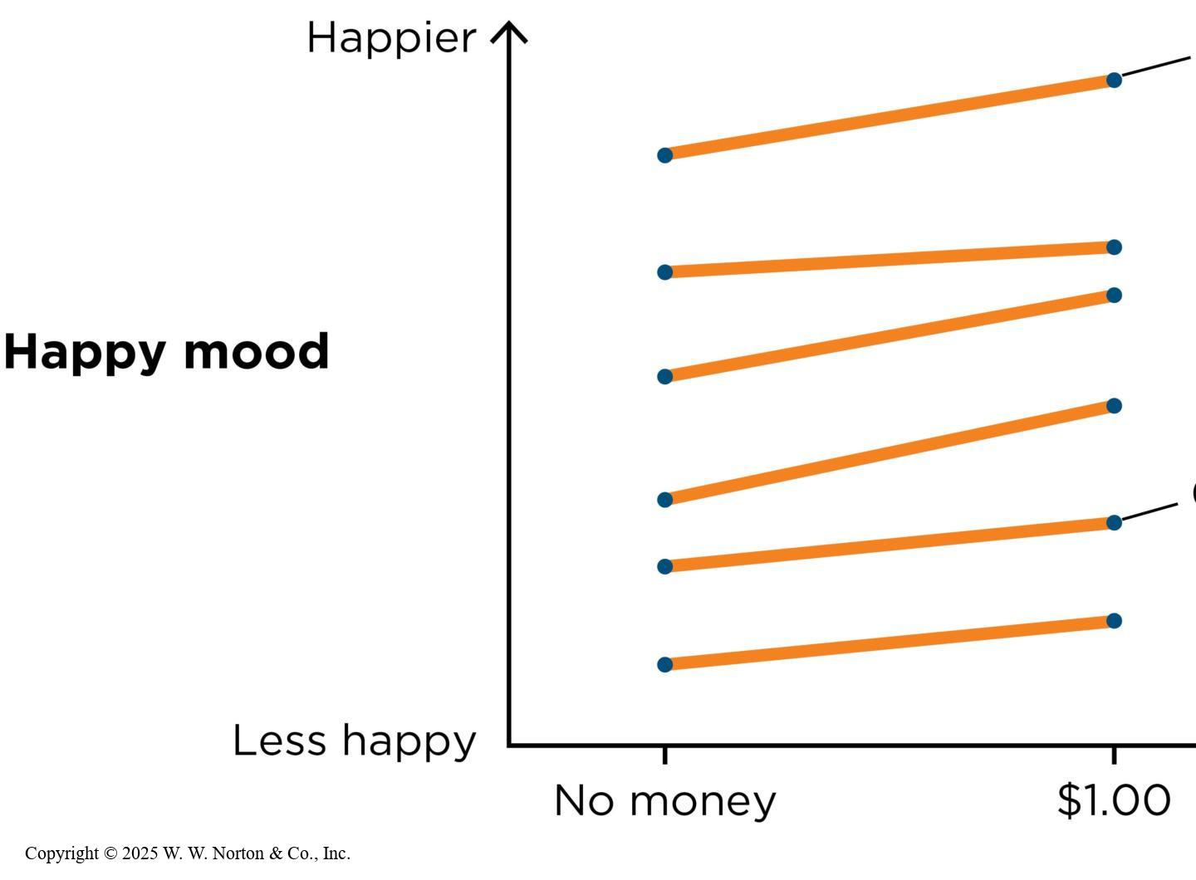
Individual Differences: Solution 1
Change the design to a within-groups or matched-groups design.
Notes:
Figure 11.16: Within-Groups Designs Control for Individual Differences
When each person participates in both levels of the independent variable, the individual differences are controlled for, and it is easier to see the effect of the independent variable.
There are two solutions for reducing the effects of individual differences.
1. Change the design: Use a within-groups design instead of an independent-groups design (see graph on left). When you do this, then each person receives both levels of the IV, and individual differences are controlled for. It’s easier to see the effect of the IV when individual differences aren’t obscuring between-groups differences. You can also use a matched-groups design (see graph on right). Pairs of participants are matched on an individual differences variable, and it’s easier to see the effects of the IV.
2. Add more participants: If it’s not feasible to change the design to a within-groups or matched-groups design, then try adding more participants. This will lessen the effect that any one participant has on the group average.
Copyright © 2025 W. W. Norton & Co., Inc.

Slide 26
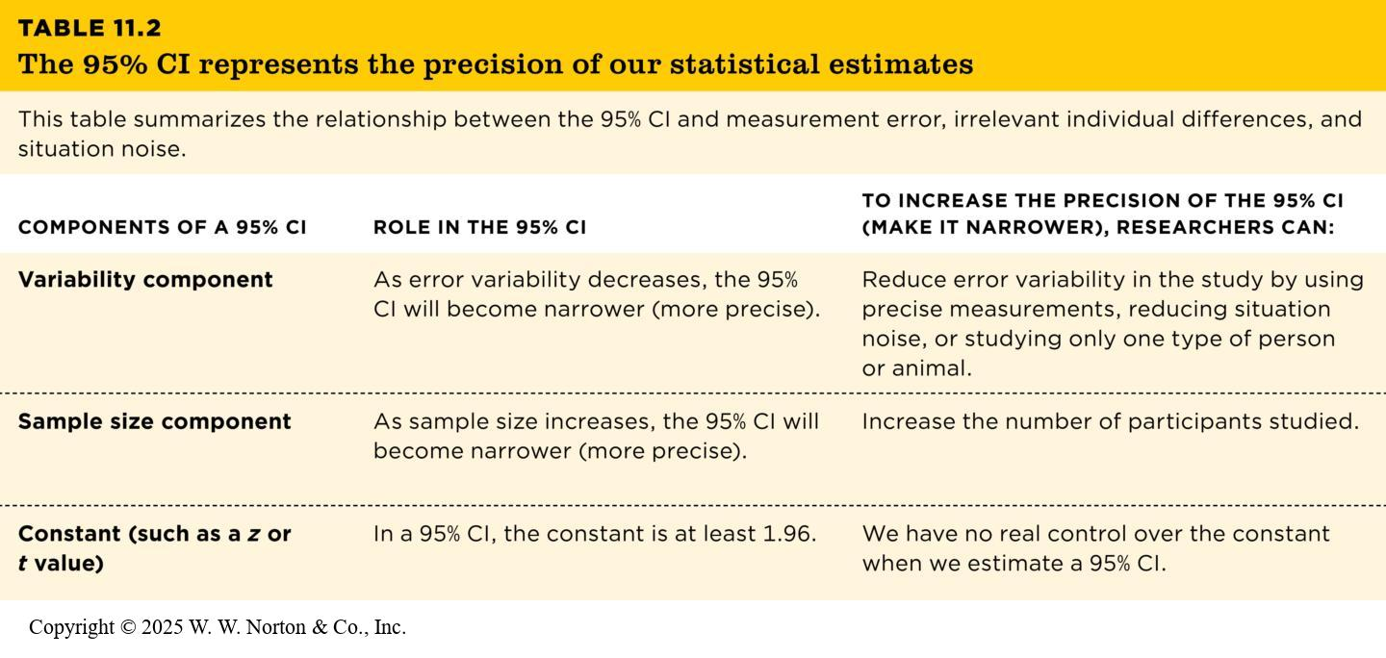
Individual Differences: Solution 2
Add more participants.
TABLE 11.2
TABLE 11.2 The 95% CI represents the precision of our statistical estimates
This table summarizes the relationship between the 95% CI and measurement error, irrelevant individual differences, and situation noise.
COMPONENTS OF A 95% CI | ROLE IN THE 95% CI | TO INCREASE THE PRECISION OF THE 95% CI (MAKE IT NARROWER), RESEARCHERS CAN:
Variability component | As error variability decreases, the 95% CI will become narrower (more precise). | Reduce error variability in the study by using precise measurements, reducing situation noise, or studying only one type of person or animal.
Sample size component | As sample size increases, the 95% CI will become narrower (more precise). | Increase the number of participants studied.
Constant (such as a z or t value) | In a 95% CI, the constant is at least 1.96. | We have no real control over the constant when we estimate a 95% CI.
Notes:
Table 11.2: The 95% CI Represents the Precision of Our Statistical Estimates
This table summarizes the relationship between the 95% CI and measurement error, irrelevant individual differences, and situation noise.
Copyright © 2025 W. W. Norton & Co., Inc.

Slide 27
Situation Noise
Situation noise is any kind of external distraction that could cause variability within groups that obscures between-groups differences.
It can be minimized by controlling the surroundings of an experiment.
Notes:
Situation noise: External distractions of any kind that obscure between-groups difference and cause variability within groups.
Example: This includes smells, sights, and sounds that might distract participants and increase within-groups variability; it adds unsystematic variability to each group situation by controlling the surroundings of an experiment that might affect the DV.
Example: Testing participants in a quiet room with no outside odors.

Slide 28
95% CIs and Precision
TABLE 11.2
TABLE 11.2 The 95% CI represents the precision of our statistical estimates
This table summarizes the relationship between the 95% CI and measurement error, irrelevant individual differences, and situation noise.
COMPONENTS OF A 95% CI | ROLE IN THE 95% CI | TO INCREASE THE PRECISION OF THE 95% CI (MAKE IT NARROWER), RESEARCHERS CAN:
Variability component | As error variability decreases, the 95% CI will become narrower (more precise). | Reduce error variability in the study by using precise measurements, reducing situation noise, or studying only one type of person or animal.
Sample size component | As sample size increases, the 95% CI will become narrower (more precise). | Increase the number of participants studied.
Constant (such as a z or t value) | In a 95% CI, the constant is at least 1.96. | We have no real control over the constant when we estimate a 95% CI.
Notes:
Table 11.2: The 95% CI Represents the Precision of Our Statistical Estimates
This table summarizes the relationship between the 95% CI and measurement error, irrelevant individual differences, and situation noise.
Copyright © 2025 W. W. Norton & Co., Inc.

Slide 29
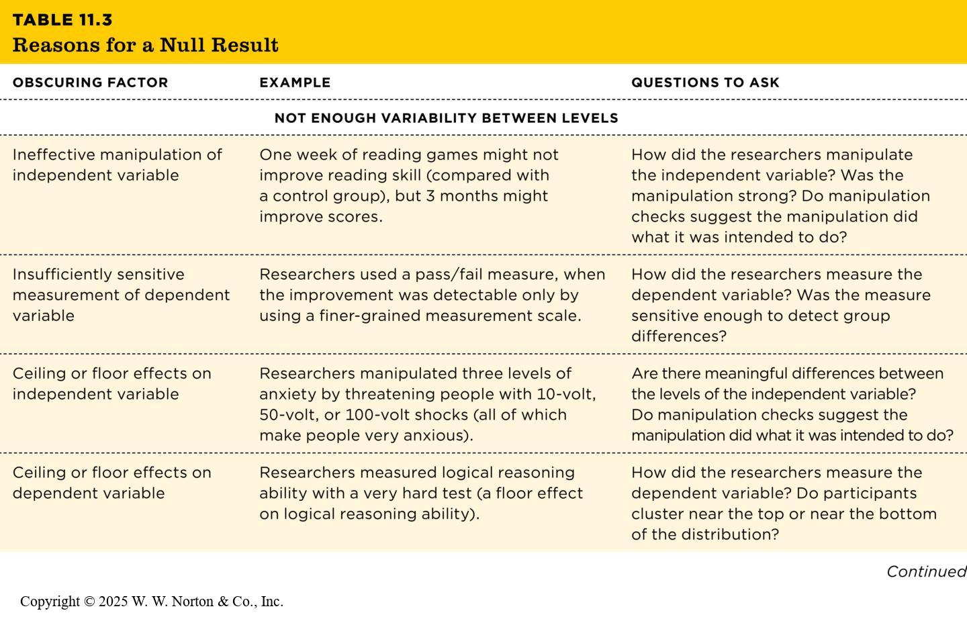
Obscuring Factors and Null Results
TABLE 11.3
TABLE 11.3 Reasons for a Null Result
OBSCURING FACTOR | EXAMPLE | QUESTIONS TO ASK
NOT ENOUGH VARIABILITY BETWEEN LEVELS
Ineffective manipulation of independent variable | One week of reading games might not improve reading skill (compared with a control group), but 3 months might improve scores. | How did the researchers manipulate the independent variable? Was the manipulation strong? Do manipulation checks suggest the manipulation did what it was intended to do?
Insufficiently sensitive measurement of dependent variable | Researchers used a pass/fail measure, when the improvement was detectable only by using a finer-grained measurement scale. | How did the researchers measure the dependent variable? Was the measure sensitive enough to detect group differences?
Ceiling or floor effects on independent variable | Researchers manipulated three levels of anxiety by threatening people with 10-volt, 50-volt, or 100-volt shocks (all of which make people very anxious). | Are there meaningful differences between the levels of the independent variable? Do manipulation checks suggest the manipulation did what it was intended to do?
Ceiling or floor effects on dependent variable | Researchers measured logical reasoning ability with a very hard test (a floor effect on logical reasoning ability). | How did the researchers measure the dependent variable? Do participants cluster near the top or near the bottom of the distribution?
Notes:
Table 11.3: Reasons for a Null Result
This table summarizes the reasons for null results. We have discussed how we might not detect an effect when it exists because we don’t have enough variability between-groups or we might have too much variability within-groups. However, a third alternative is that there truly is no difference between your groups, and the IV has no affect on the DV. If the study has adequate power and no difference was found, then there may be a true null effect.
Copyright © 2025 W. W. Norton & Co., Inc.

Slide 30
The Opposite of Obscuring: Power and Precision
Power is the likelihood that a study will yield a statistically significant result when the IV really has an effect.
Notes:
Power is an aspect of statistical validity. A study with more power has a greater likelihood will return an accurate result when the independent variable really has an effect. Precision and power go hand in hand; if the effect is really there in real life, a powerful study will estimate it precisely with a reasonably narrow CI. A within-groups design, a strong manipulation, a larger number of participants, and less situation noise are all things that improve the prevision of our estimates. Of these the easiest way to increase precision and power is (usually) to add more participants.
Studies with large samples have two major advantages:
Large samples make the CI narrow: They lead to a narrower CI, and one more likely to be statistically significant.
Effects detected from small samples sometimes can’t be repeated, because unusual or outlier datapoints will have a much larger effect. This leads to an unusual effect that is hard to replicate, and a very wide CI. Overall, larger samples have better chance at estimating effects accurately.

Slide 31
Null Results Should Be Reported Transparently
If a study provides strong evidence that there’s probably no real effect, scientists should report that result transparently.
Notes:
When an experiment results in a null effect (the CI includes zero), what should you conclude? Firstly, we check for any of the obscuring factors discussed in this chapter. If any of these factors could have been a problem, that could explain why the experiment showed a null effect.
On the other hand, if the study was powerful and precise and still showed a CI that included zero, we still report that result, however disappointing. Doing otherwise would violate Merton’s norm of disinterestedness, so we should accept what the data tell us. Null results are just as valuable as the other studies testing the same question and are important to consider among the full body of evidence.

Slide 32
Null Effects May Be Published Less Often
Null results can be just as interesting as results that show group differences.
Journals are becoming increasingly likely to publish null effect research.
Null effects may be less likely to be reported in the popular media than other results.

